Slide 1




VELORA — Violation Evaluation and Lane Orchestration for
Real-time Road Automation
CAPSTONE PROJECT PRESENTATION
Track / Job Profile:
AI & Data Science / Microsoft Machine Learning Developer
Team:
5G — Wesam Fathy, Basma Hassan, Tasneem Faisal, Habiba Adel, Salma Abdelhaleem
Supervisor:
Track Head: Dr. Rania ElGohary | Supervisor: Dr. Mohamed El Badawi | Eng. Engy Ayman, Eng. Sama, Eng. Antonios Malak
Submission:
June 2026

Slide 2
Agenda
01
Team Introduction
05
Technology Stack & Implementation
02
Problem Statement & Background
06
Demo & Results
03
Objectives & Scope
07
Impact & Future Work
04
Proposed Solution & Architecture
DiGiLiANS — Digital Pioneers Initiative | Capstone Project Defense 2026
2

Slide 3
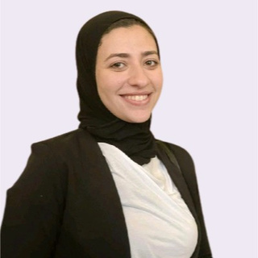



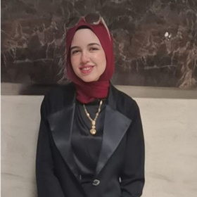
Team Introduction
Basma Hassan Qutb
Wesam Fathy Masoud Omar
Tasneem Faisal Makhlouf
Habiba Adel Saleh
Salma Mahmoud Abdelhaleem
Computer Vision & AI Engineer
Computer Vision & AI Engineer
Systems Engineer — Traffic Signal
Systems Engineer — Traffic Signal
AI Agent, Deployment
& Dashboard
Violation Engine.
YOLOv8 detection.
MiDaS depth pipeline.
DeepLabV3+ segmentation.
Documentation preparation.
Data preparation
YOLOv8 training
Pothole detection
Severity classification
Documentation preparation.
Poster preparation
LaneOrchestrator FSM design.
traffic density model.
demo video.
presentation preparation.
FSM implementation.
asyncio pipeline.
simulation harness.
audit logging,
traffic density model
n8n workflow.
Streamlit dashboard.
violation model.
integration testing.
presentation preparation.
Supervisor / Track Head: Dr. Rania ElGohary & Dr. Mohamed El Badawi
DiGiLiANS — Digital Pioneers Initiative | Capstone Project Defense 2026
3

Slide 4
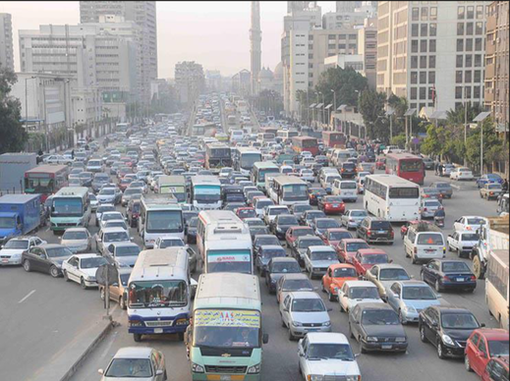
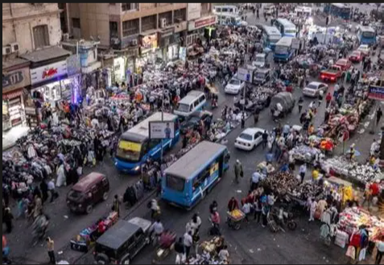
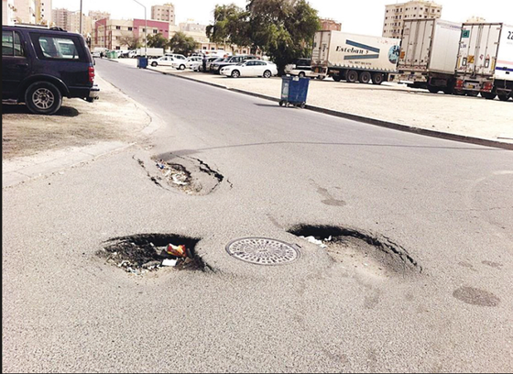
Problem Statement
💡 Municipalities cannot continuously cover all streets — gaps in monitoring lead to delayed reporting and fragmented decision-making across authorities.
Urban streets in Egyptian cities face persistent sidewalk violations (illegal vendors, blocked pedestrian paths) forcing pedestrians into vehicle lanes.
Road surface deterioration (potholes) goes undetected for long periods due to manual, scheduled inspections — increasing vehicle damage and maintenance costs.
Most intersections use fixed-time signals ignoring real-time traffic density, causing unnecessary delays during peak hours.
Emergency vehicles face intersection delays with no consistent prioritization mechanism, threatening life-saving response times.
Existing solutions are fragmented, reactive, and rely on expensive dedicated hardware — with no integration between violation detection, road assessment, and signal control.
DiGiLiANS — Digital Pioneers Initiative | Capstone Project Defense 2026
4

Slide 5
Objectives & Project Scope
💡 All 4 modules share a common data flow — a single camera feed simultaneously feeds violation detection, road damage assessment, and adaptive signal control.
SMART Objectives
What’s In Scope
Objective 1: Design an integrated AI pipeline combining YOLOv8, DeepLabV3+, and MiDaS with rule-based ViolationEngine for depth-aware sidewalk violation detection.
Objective 2: Develop severity-classified pothole detection (low/medium/high) using YOLOv8 fine-tuned on Egyptian road imagery, with automated municipal dispatch.
Objective 3: Build a formally specified FSM-based adaptive traffic signal controller (LaneOrchestrator) with pedestrian safety constraints and emergency vehicle preemption.
Objective 4: Deliver a Streamlit authority dashboard + n8n automation pipeline with full audit logging, demonstrated through integration testing across images, videos, and live streams.
Real-time violation detection
(3-model pipeline: YOLOv8 +DeepLabV3+ + MiDaS)
Pothole detection and severity classification with automated maintenance alerts via n8n
Adaptive traffic signal control with emergency vehicle preemption (FSM-based LaneOrchestrator)
Interactive Streamlit authority dashboard with live monitoring and historical reporting
Operates on existing CCTV infrastructure — zero new hardware required
End-to-end incident management: detection → alert → authority notification in under 2 minutes
DiGiLiANS — Digital Pioneers Initiative | Capstone Project Defense 2026
5

Slide 6
Proposed Solution
💡 No comparable open-source platform combines all 4 capabilities (violation detection, road damage, adaptive signals, emergency preemption) in one unified system.
VELORA is a unified AI platform for intelligent road monitoring, urban violation detection, road surface assessment, and adaptive traffic management — all on existing camera infrastructure.
4 cooperating modules: Street Violation Detection | Pothole Detection & Road Damage Assessment | Traffic Signal Controller | n8n Incident Management Pipeline.
3-model perception pipeline (YOLOv8 → DeepLabV3+ → MiDaS) processes each frame: object detection, pixel-level sidewalk segmentation, and depth estimation for context-aware violation decisions.
All detections feed an n8n event-driven workflow dispatching automated alerts to enforcement bureaus, municipal maintenance, and the LaneOrchestrator emergency protocol.
Streamlit authority dashboard gives personnel real-time visibility into violations, road damage, signals, and alerts — with human review before any citation becomes formal enforcement.
Delivers faster incident response, proactive maintenance scheduling, and guaranteed emergency vehicle transit without dedicated sensor hardware investment.
DiGiLiANS — Digital Pioneers Initiative | Capstone Project Defense 2026
6

Slide 7
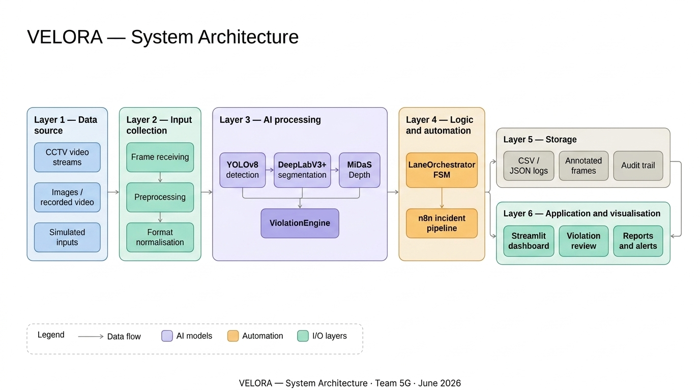
System Architecture
DiGiLiANS — Digital Pioneers Initiative | Capstone Project Defense 2026
7

Slide 8
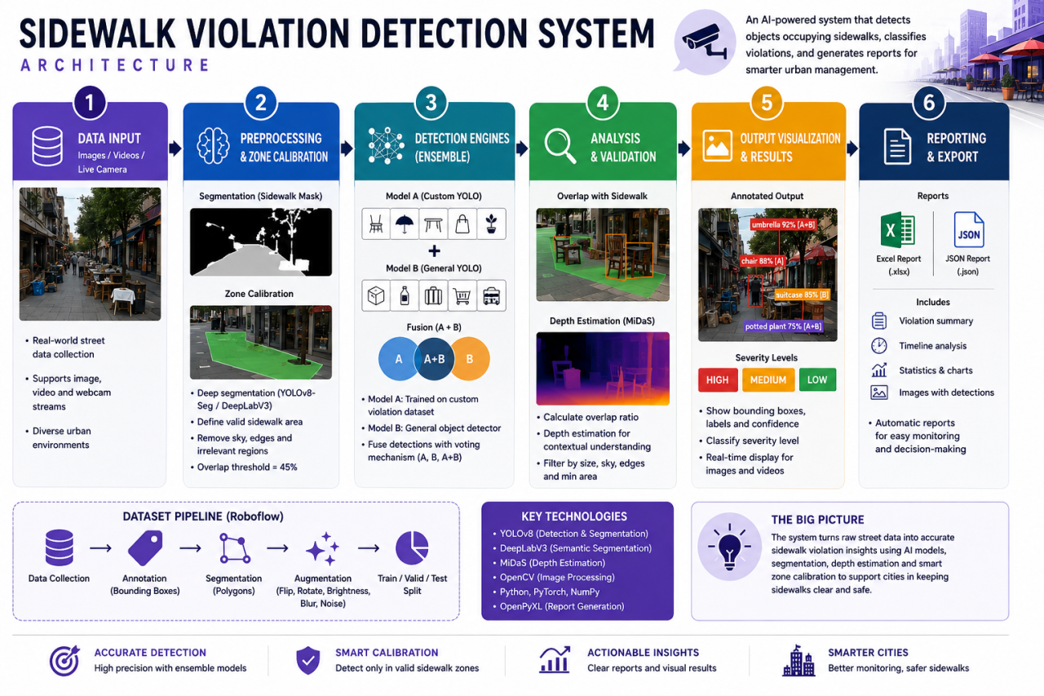
Violation Detection Model
DiGiLiANS — Digital Pioneers Initiative | Capstone Project Defense 2026
7

Slide 9
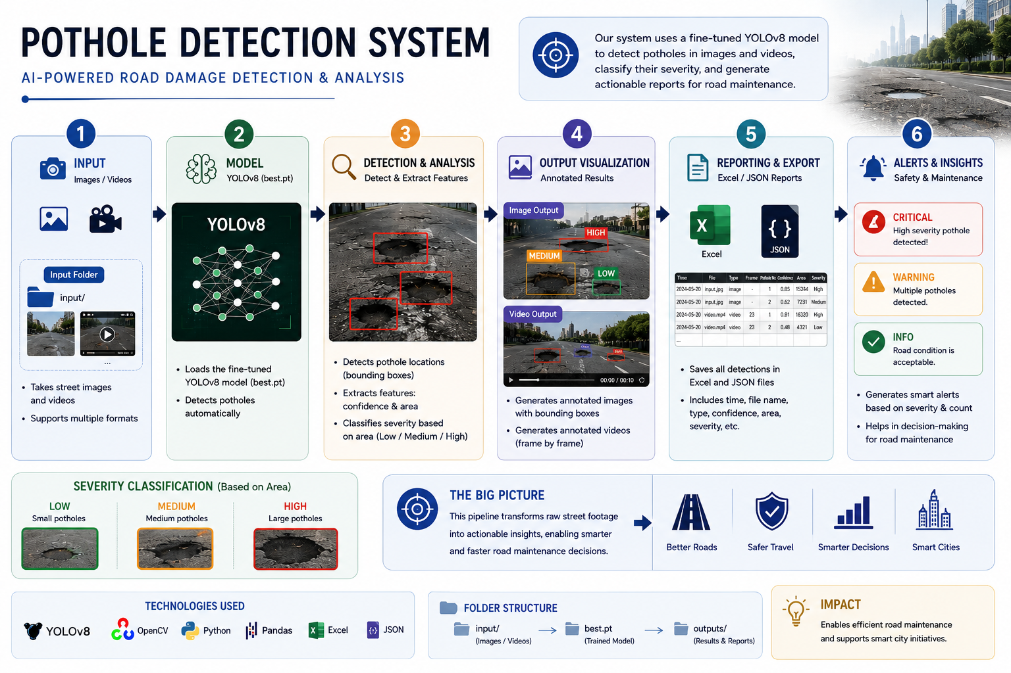
Pothole Detection Model
DiGiLiANS — Digital Pioneers Initiative | Capstone Project Defense 2026
7

Slide 10
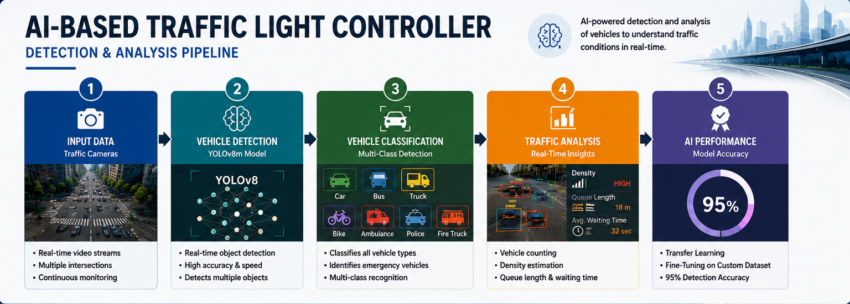
Traffic Light Controler 1
DiGiLiANS — Digital Pioneers Initiative | Capstone Project Defense 2026
7

Slide 11
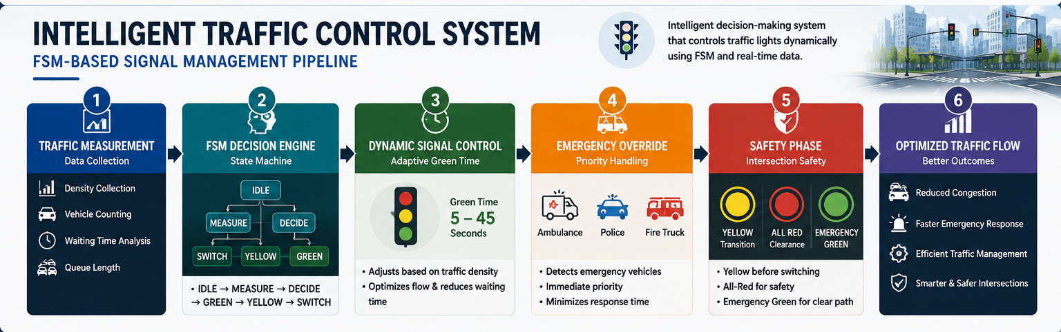
Traffic Light Controler 2
DiGiLiANS — Digital Pioneers Initiative | Capstone Project Defense 2026
7

Slide 12
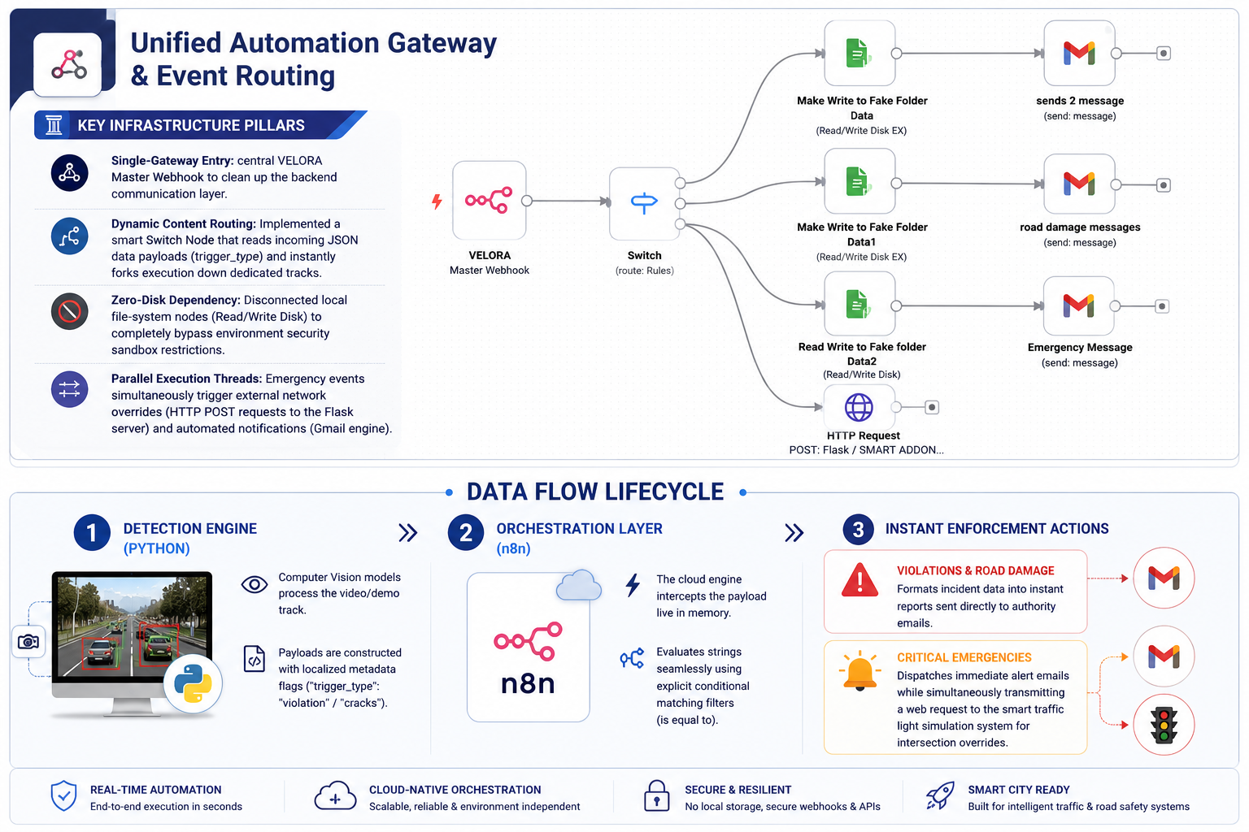
Unified Automation Gateway & Event Routing
DiGiLiANS — Digital Pioneers Initiative | Capstone Project Defense 2026
7

Slide 13
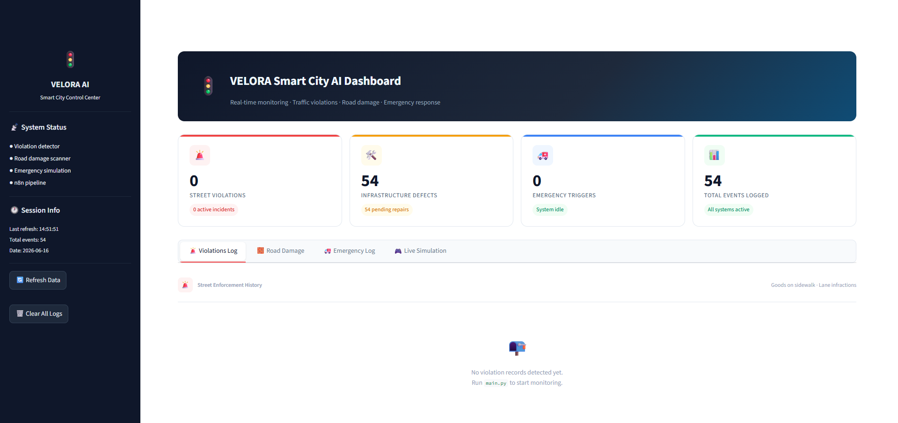
Implementation & Demo
Screenshot / Demo 1
[Insert Streamlit dashboard screenshot showing annotated violation detection output]
Screenshot / Demo 2
[Insert pothole severity classification output or LaneOrchestrator Pygame simulation]
DiGiLiANS — Digital Pioneers Initiative | Capstone Project Defense 2026
11

Slide 14
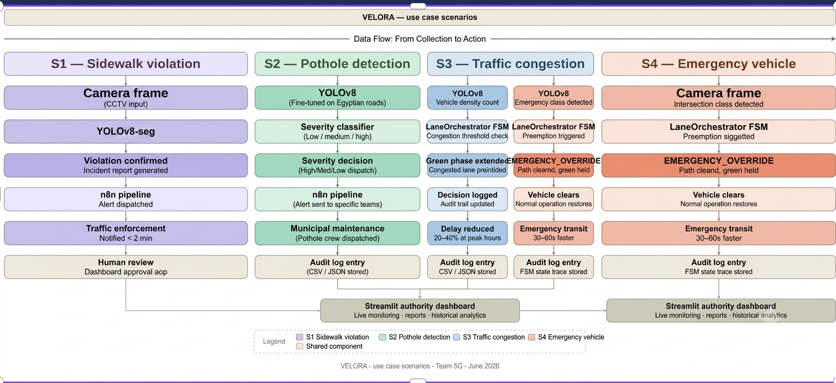
Workflow / Use Case Diagram
DiGiLiANS — Digital Pioneers Initiative | Capstone Project Defense 2026
10

Slide 15
Technology Stack
Frontend
Backend
Database
Streamlit (Authority Dashboard)
Simulation Using Pygame
Python + Flask + OpenCV 4.8
Structured CSV + JSON file-based logs | n8n Workflow Automation/ images dataset collected and annotated manually
AI / ML
Cloud & DevOps
Security
YOLOv8x / YOLOv8x (Ultralytics) | DeepLabV3+ ResNet-101 |
MiDaS DPT-Large | PyTorch 2.0+
Git / GitHub | pytest + custom simulation frameworks | YAML + PyYAML
HMAC-signed webhook tokens | Source whitelists (preemption) | Append-only audit logs | YAML schema validation
DiGiLiANS — Digital Pioneers Initiative | Capstone Project Defense 2026
8

Slide 16
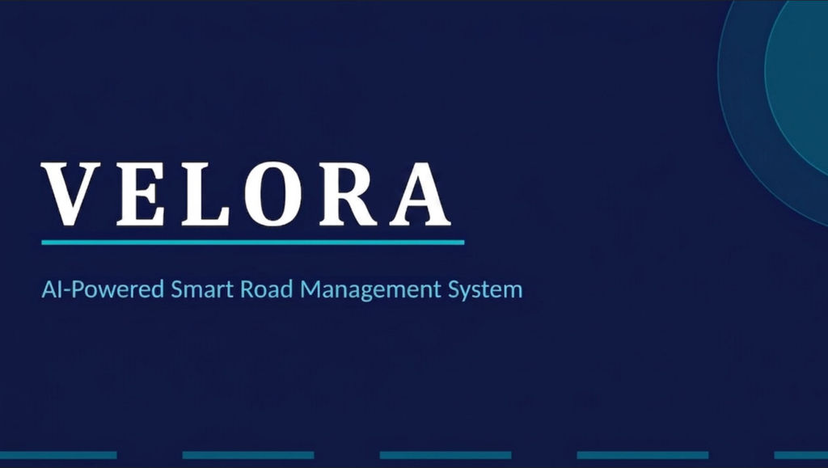
Team Contributions
💡 All members participated in: system planning, code reviews, integration testing, and final presentation preparation.
Key highlights from the demo:
Live 3-model detection pipeline: YOLOv8 + DeepLabV3+ + MiDaS running in sequence on video frames
Severity-classified pothole detection with automated n8n maintenance alert dispatch
Emergency preemption scenario: FSM transitions to EMERGENCY_OVERRIDE, clears lane, restores normal operation
Live Demo Link / QR Code:
https://drive.google.com/drive/folders/1W1W9GIbKBIgqMCQhBviRm8cMClHgXY-C?usp=drive_link
DiGiLiANS — Digital Pioneers Initiative | Capstone Project Defense 2026
16

Slide 17
Project Impact & Innovation
Automates pedestrian safety enforcement and removes sidewalk obstructions in dense Egyptian urban environments where manual monitoring cannot scale.
Shifts road maintenance from reactive to proactive: severity-classified pothole data directly maps to municipal repair prioritization, reducing long-term infrastructure costs.
Innovation — depth-aware 3-model pipeline: single-model systems generate high false positives from camera perspective distortion; VELORA’s ViolationEngine uses MiDaS depth to eliminate this, achieving significantly lower false positive rates.
Directly supports Egypt Vision 2030: smart city development, digital urban infrastructure, and public safety improvement through AI-driven automation.
Modular architecture supports city-wide deployment, cloud scaling (Azure/AWS), and integration with smart city platforms — all without replacing existing CCTV infrastructure.
DiGiLiANS — Digital Pioneers Initiative | Capstone Project Defense 2026
14

Slide 18
Future Work
All 6 areas apply to VELORA
Performance & Optimization
Integrate RL agent to replace rule-based phase duration calculation
Train on historical congestion sequences from operational deployment using existing simulation harness
Feature Enhancement
Multilingual dashboard (Arabic + English) for Egyptian municipal contexts
Mobile app for field inspection teams to review and acknowledge pothole and violation alerts
Testing & Validation
Broader field testing on live Egyptian road environments beyond recorded footage
Live CCTV stream integration (current version processes pre-recorded footage and images)
Integration & Deployment
Hardware abstraction layer for physical traffic signal controllers (RS-485, NEMA TS-2, NTCIP)
Physical emergency preemption hardware integration (Opticom infrared, GPS-based systems)
Scale & Wider Reach
Cloud deployment (Azure/AWS) for multi-city scalable operation
Multi-intersection green wave coordination along arterial corridors
Research & Impact
Publish findings on depth-aware violation detection and FSM-based adaptive signal control
Open-source the platform to support research and smart city adoption
DiGiLiANS — Digital Pioneers Initiative | Capstone Project Defense 2026
15

Slide 19
Team Contributions
💡 All members participated in: system planning, code reviews, integration testing, and final presentation preparation.
Basma Hassan Qutb — ViolationEngine implementation, YOLOv8 multi-class detection, MiDaS depth pipeline, DeepLabV3+ segmentation, zone calibration
Wesam Fathy Masoud Omar — Cairo street footage dataset collection & annotation, Egyptian road damage dataset, YOLOv8- fine-tuning, traffic density model, model evaluation
Tasneem Faisal Makhlouf — LaneOrchestrator FSM design, asyncio pipeline, congestion-based phase duration algorithm, pedestrian constraint enforcer, emergency preemption protocol
Habiba Adel Saleh — LaneOrchestrator FSM implementation, ConfigLoader integration, simulation test environment, audit logging system, pytest test suite
Salma Mahmoud Abdelhaleem — Streamlit authority dashboard (frontend + backend), violation model contributions, end-to-end integration testing, performance benchmarking, demo video
All members participated in: planning, code reviews, testing, and final integration
DiGiLiANS — Digital Pioneers Initiative | Capstone Project Defense 2026
16

Slide 20
References & Resources
Academic & Technical References
Tools, Datasets & Repositories
Ranftl et al. — Towards Robust Monocular Depth Estimation (Intel ISL) — MiDaS foundation paper
Chen et al. — Rethinking Atrous Convolution for Semantic Image Segmentation — DeepLabV3+ foundation paper
Webster, F.V. — Traffic Signal Settings, Road Research Technical Paper No. 39 — Signal timing theory
Ultralytics YOLOv8 Documentation — Primary object detection framework. https://docs.ultralytics.com
GitHub Repository: https://github.com/tasneemfaisal08/VELORA-Violation-Evaluation-and-Lane-Orchestration-for-Real-time-Road-Automation
Datasets: BDD100K (urban scene detection), RDD2022 (road damage), custom Egyptian road footage
Demo / Dashboard: https://drive.google.com/drive/folders/1W1W9GIbKBIgqMCQhBviRm8cMClHgXY-C
Frameworks: PyTorch (pytorch.org/docs) | OpenCV (docs.opencv.org) | n8n (docs.n8n.io)
💡 All references cited in the full project documentation. See References section (Section 20) for complete list.
DiGiLiANS — Digital Pioneers Initiative | Capstone Project Defense 2026
17

Slide 21
Thank You!
Team Name: 5G — Digilians VELORA
Track: AI & Data Science / Microsoft Machine Learning Developer
GitHub: https://github.com/tasneemfaisal08/VELORA-Violation-Evaluation-and-Lane-Orchestration-for-Real-time-Road-Automation| Demo: https://drive.google.com/drive/folders/1W1W9GIbKBIgqMCQhBviRm8cMClHgXY-C
DiGiLiANS — Digital Pioneers Initiative | Capstone Project Defense 2026

